Slide 1

D AGEDO

Slide 2

Clinical syndrome of systemic illness accompanied by bacteremia occurring in the first month of life
Incidence
  1-8/1000 live births
  13-27/1000 live births for infants < 1500g
Mortality rate is 13-25%
  Higher rates in premature infants and those with early fulminant disease
NEONATOLOGY AMREF

Slide 3

First 5-7 days of life
Usually multisystem illness with prominent respiratory symptoms (probably due to aspiration of infected amniotic fluid)
High mortality rate
  5-20%
Typically acquired during intrapartum period from maternal genital tract
  Associated with maternal chorioamnionitis
NEONATOLOGY AMREF

Slide 4

May occur as early as 5 days but is most common after the first week of life
Less association with obstetric complications
Usually have an identifiable focus
  Most often meningitis or sepsis
Acquired from maternal genital tract or human contact
NEONATOLOGY AMREF

Slide 5

Occurs in high-risk newborns & is related to
  the underlying illness of the infant
  the flora in the NBU/NICU environment
  invasive monitoring
Breaks in the barrier function of the skin and intestine allow for opportunistic infection
NEONATOLOGY AMREF

Slide 6

Primary sepsis
  Group B streptococcus
  Gram-negative enterics (esp. E. coli)
  Listeria monocytogenes, Staphylococcus, other streptococci (entercocci), anaerobes, H. flu
Nosocomial sepsis
  Varies by nursery
  Staphylococcus epidermidis, Pseudomonas, Klebsiella, Serratia, Proteus, and yeast are most common
NEONATOLOGY AMREF

Slide 7

Prematurity and low birth weight
Premature and prolonged rupture of membranes
Maternal peripartum fever
Amniotic fluid problems (i.e. mec, chorio)
Resuscitation at birth, fetal distress
Multiple gestation
Invasive procedures
Other factors: sex, race, variations in immune function, hand washing in the NICU
NEONATOLOGY AMREF

Slide 8

Clinical signs and symptoms are nonspecific
Differential diagnosis
  RDS
  Metabolic disease
  Hematologic disease
  CNS disease
  Cardiac disease
  Other infectious processes (i.e. TORCH)
NEONATOLOGY AMREF

Slide 9
Temperature irregularity (high or low)
Change in behavior
    Lethargy, irritability, changes in tone
Skin changes
    Poor perfusion, mottling, cyanosis, pallor, petechiae, rashes, jaundice
Feeding problems
    Intolerance, vomiting, diarrhea, abdominal distension
Cardiopulmonary
    Tachypnea, grunting, flaring, retractions, apnea, tachycardia, hypotension
Metabolic
    Hypo or hyperglycemia, metabolic acidosis
NEONATOLOGY AMREF

Slide 10

Cultures
  Blood
    Confirms sepsis
    94% grow by 48 hours of age
  Urine
    Don’t need in infants <24 hours old because UTIs are exceedingly rare in this age group
  CSF
    Controversial
    May be useful in clinically ill newborns or those with positive blood cultures
NEONATOLOGY AMREF

Slide 11

White blood cell count and differential
  Neutropenia can be an ominous sign
  I:T ratio > 0.2 is of good predictive value
  Serial values can establish a trend
Platelet count
  Late sign and very nonspecific
  ESR rises late
Other tests: bilirubin, glucose, electrolytes
NEONATOLOGY AMREF

Slide 12

CXR
  Obtain in infants with respiratory symptoms
  Difficult to distinguish GBS or Listeria pneumonia from uncomplicated RDS
Renal ultrasound and/or VCUG in infants with accompanying UTI
NEONATOLOGY AMREF

Slide 13

Examination of the placenta and fetal membranes for evidence of chorioamnionitis
NEONATOLOGY AMREF

Slide 14

Antibiotics
  Primary sepsis: ampicillin and gentamicin
  Nosocomial sepsis: vancomycin and gentamicin or cefotaxime
  Change treatment to specific antibiotics depending on culture sensitivity results
NEONATOLOGY AMREF

Slide 15

Respiratory
    Oxygen and ventilation as necessary
Cardiovascular
    Support blood pressure with volume expanders and/or pressors
Hematologic
    Treat DIC with FFP
CNS
    Treat seizures with phenobarbital
Metabolic
    Treat hypoglycemia/hyperglycemia and metabolic acidosis
    Correct electrolyte imbalance
NEONATOLOGY AMREF

Slide 16

GBS is the most common cause of early-onset sepsis
  0.8-5.5/1000 live births
  Fatality rate of 5-15%
10-30% of women are colonized in the vaginal and rectal areas
Most mothers are screened at 35-37 weeks gestation
If +ve commence mother on antibiotics
NEONATOLOGY AMREF

Slide 17

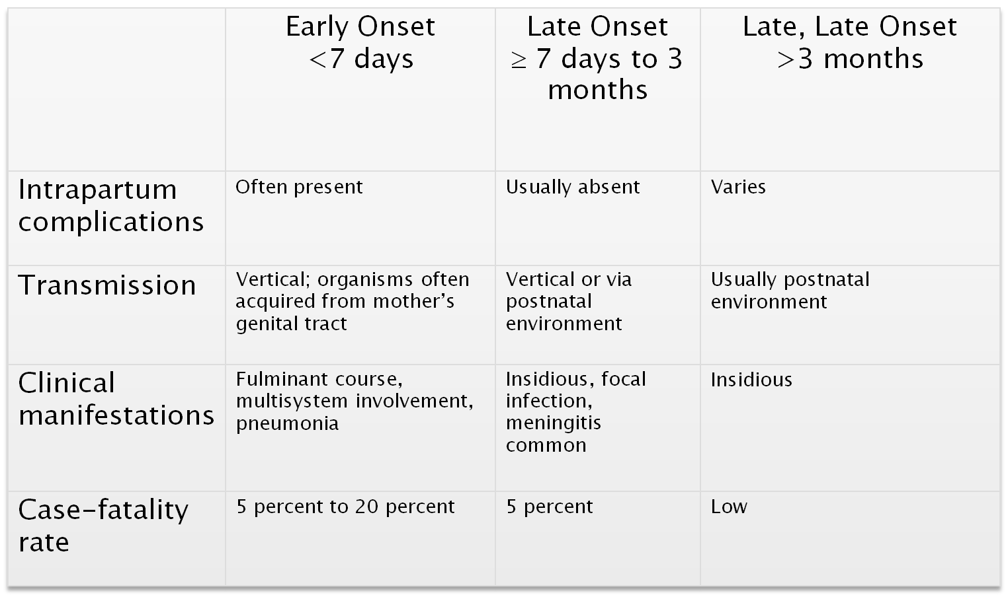
 | Early Onset <7 days | Late Onset ≥ 7 days to 3 months | Late, Late Onset >3 months
s | Often present | Usually absent | Varies
Transmission | Vertical; organisms often acquired from mother’s genital tract | Vertical or via postnatal environment | Usually postnatal environment
Clinical manifestations | Fulminant course, multisystem involvement, pneumonia | Insidious, focal infection, meningitis common | Insidious
Case-fatality rate | 5 percent to 20 percent | 5 percent | Low
M.S. Edwards, 2002a. Reprinted with permission.
© 2006, March of Dimes

Slide 18
Maswali????

Slide 19

NEONATOLOGY AMREF

Slide 20

NEONATOLOGY AMREF

